Slide 1

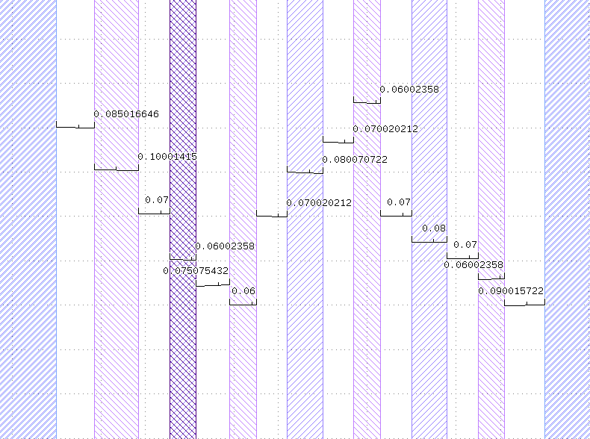
SL
CS
D
G1
G2
G3
G4
G5
SR
Disance between CNT and gates = 70nm

Slide 2
Insert vacuum probe measurements

Slide 3
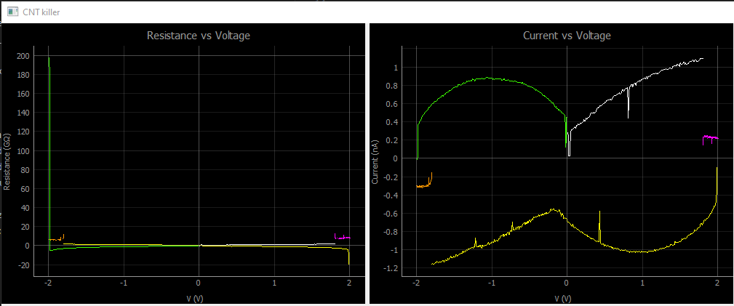
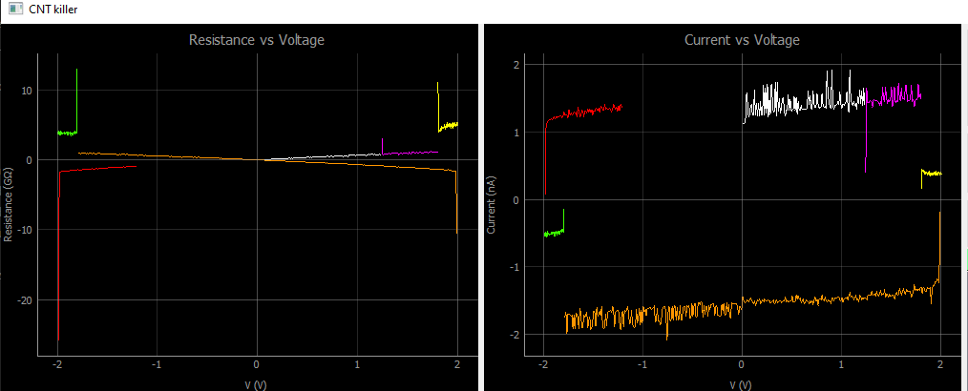
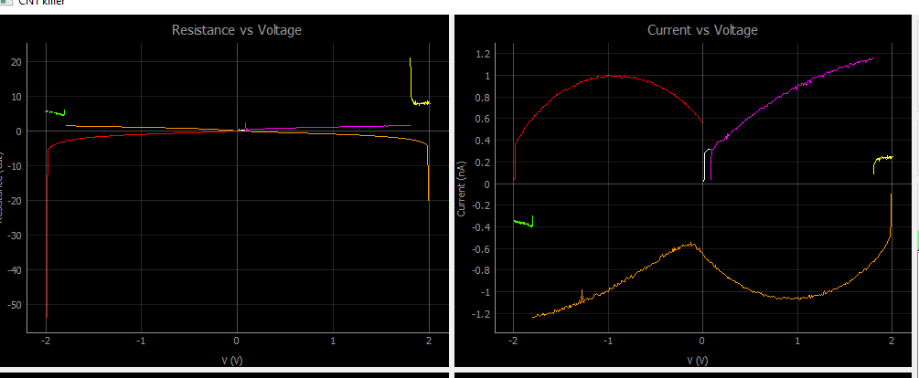
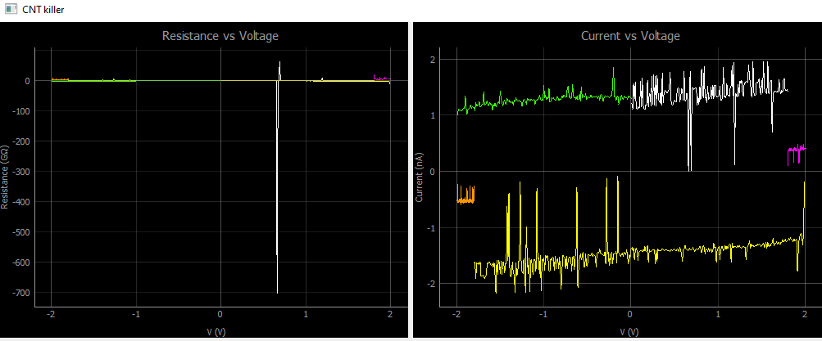
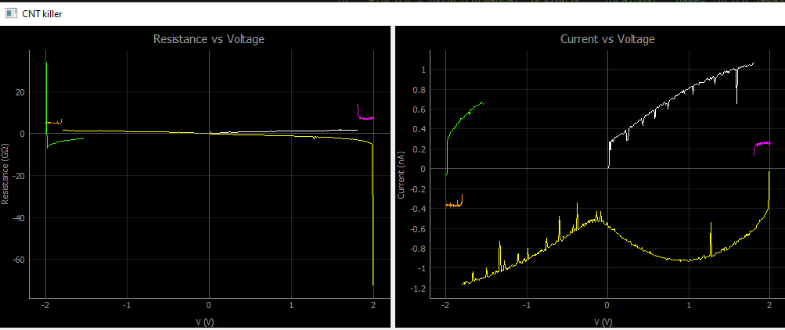
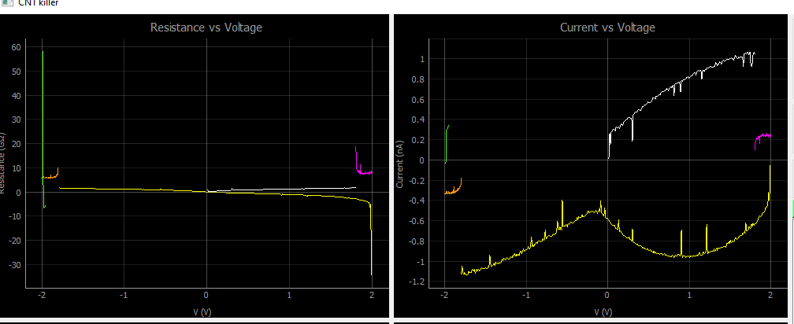
g1
cs
g2
g1
g3
g4
g5

Slide 4
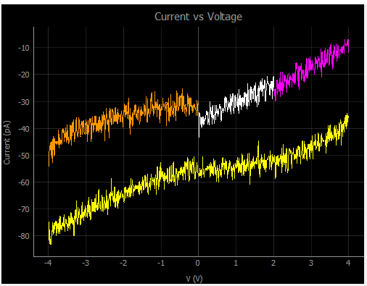
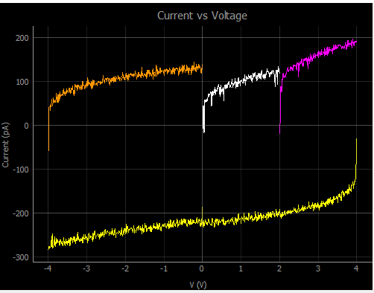
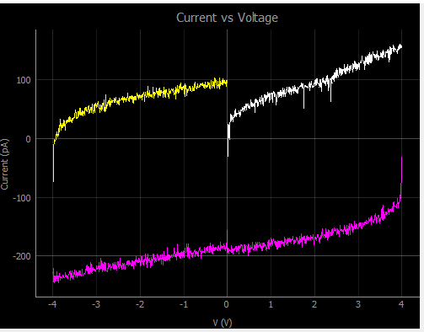
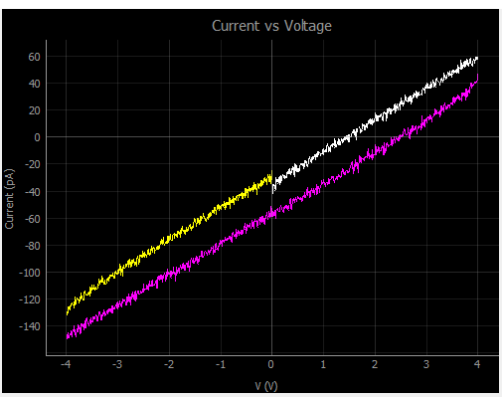
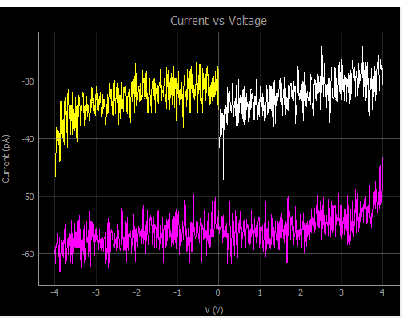
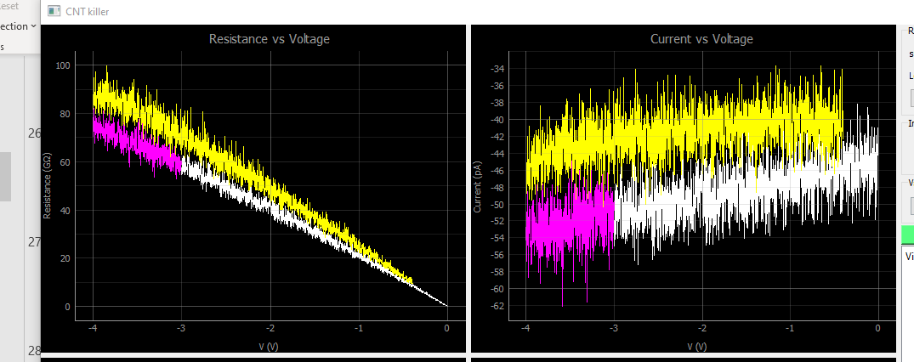
At 20mK
g1
g2
g3
g4
g5
cs

Slide 5
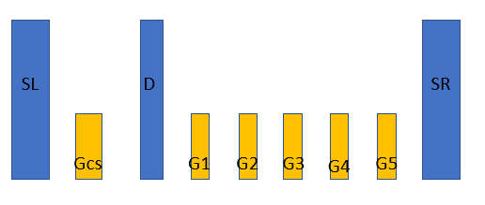
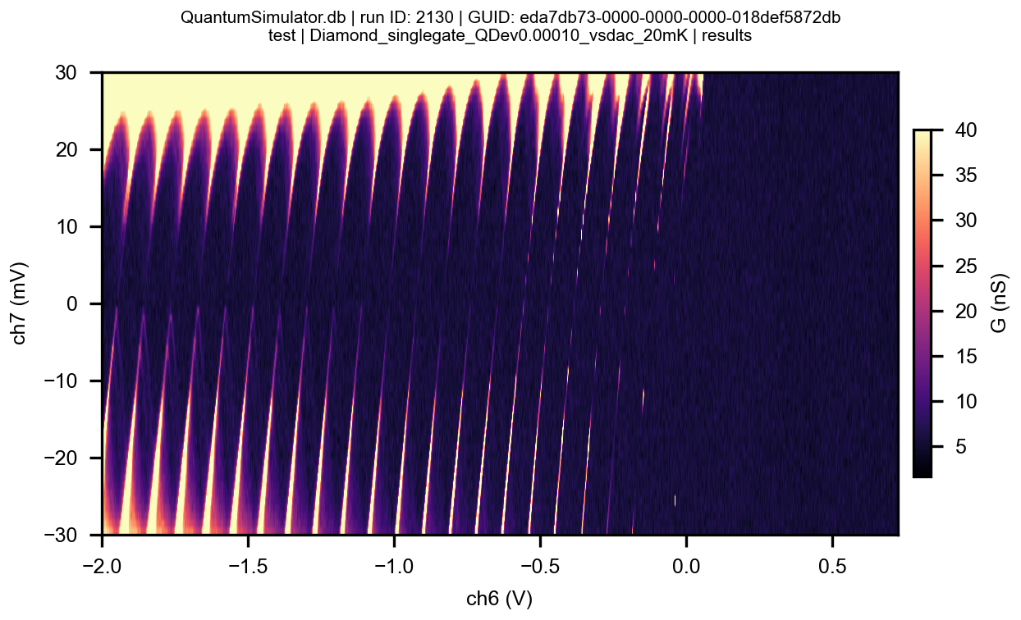
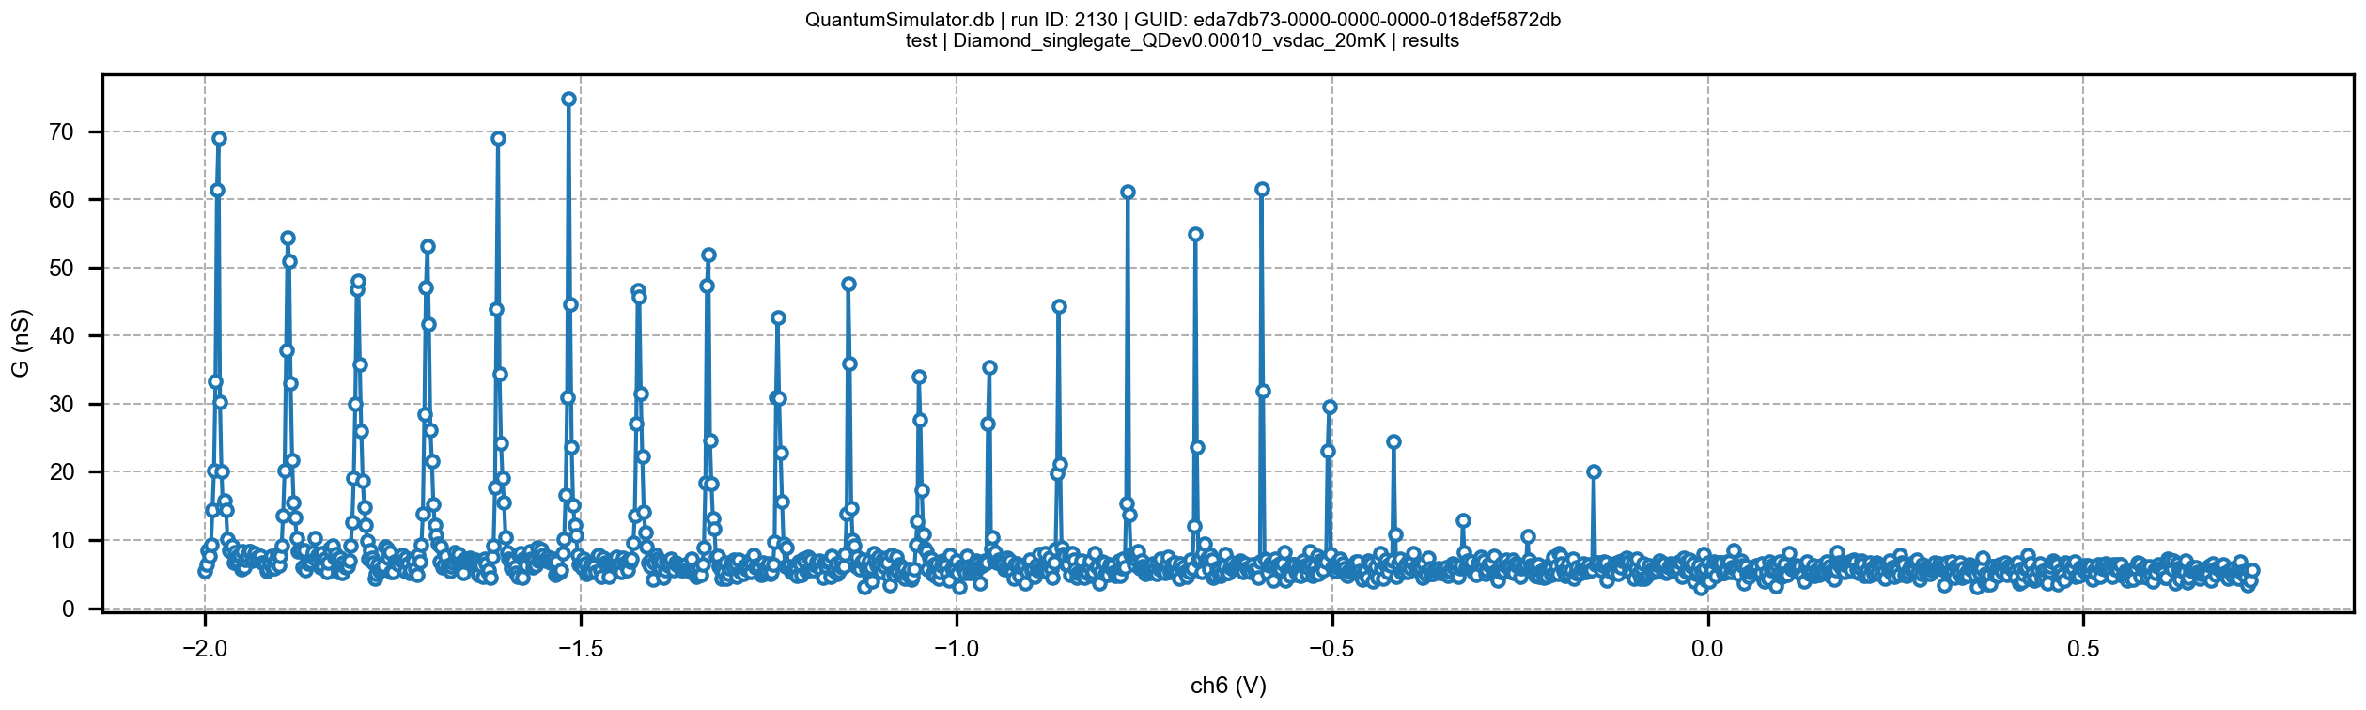
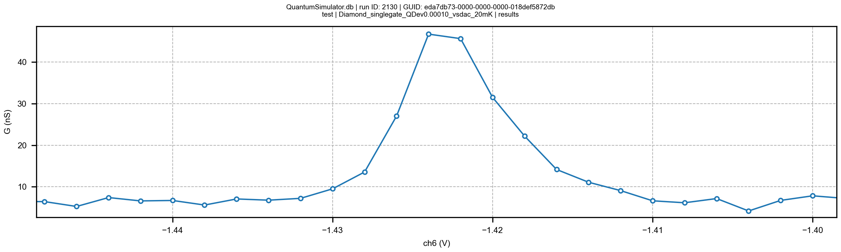
Charge sensor
Voltage SL
Voltage GCS
Voltage Sl= 16 mV

Slide 6
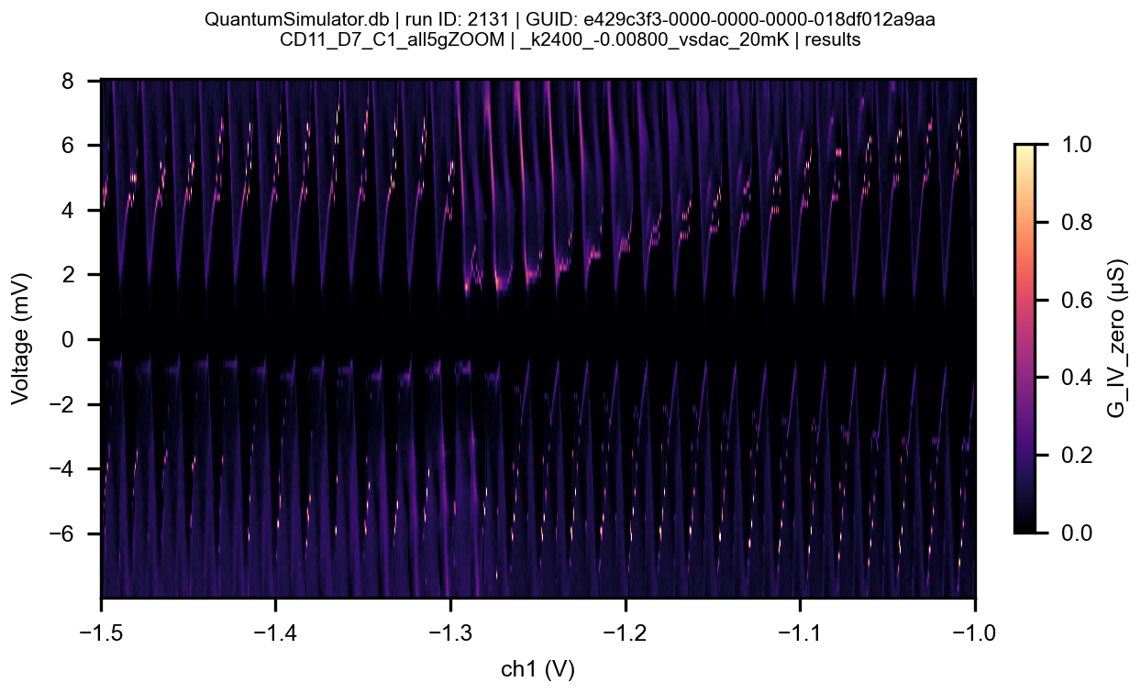

Slide 7
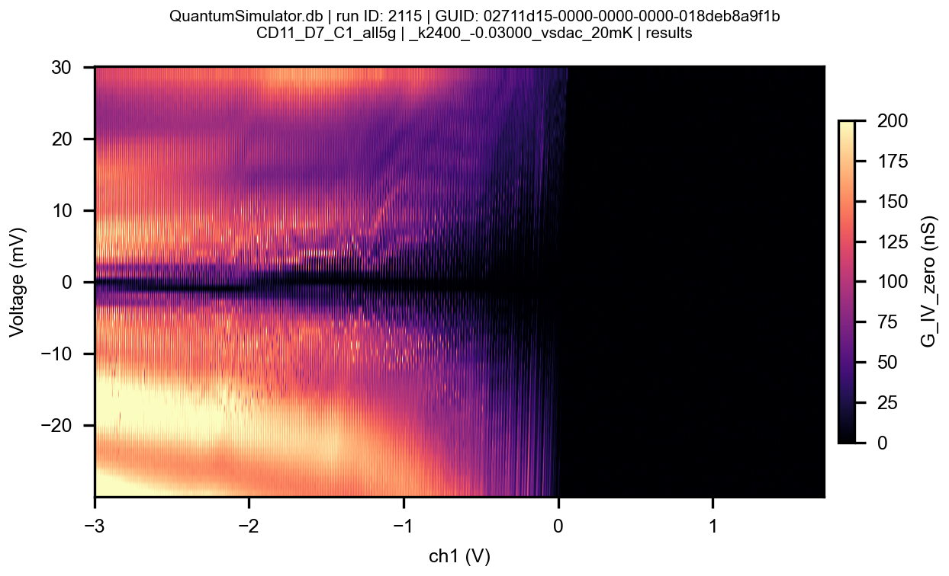

Slide 8
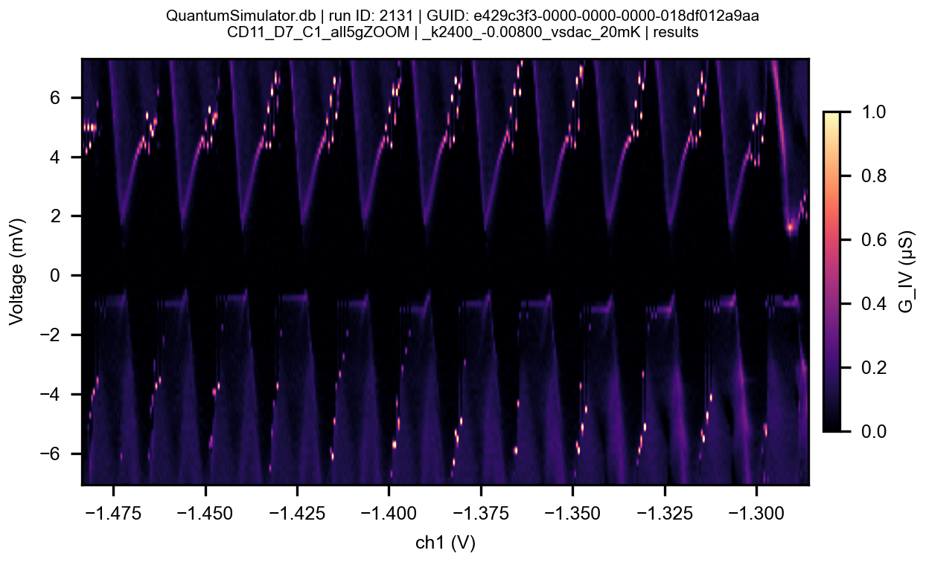

Slide 9
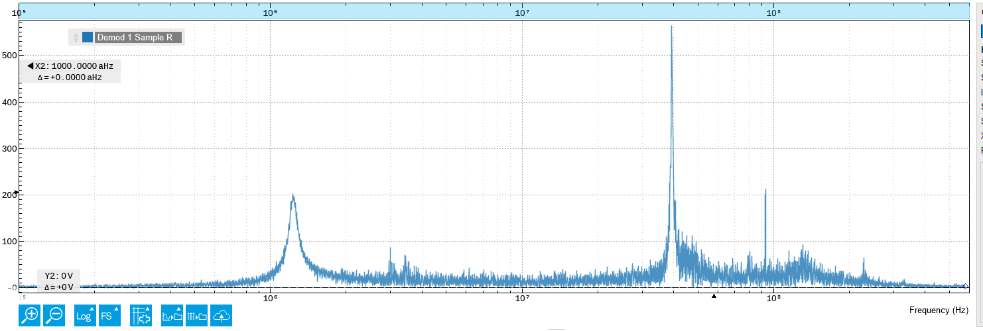
Transmission through RLC while on coulomb peak (at-130mV)

Slide 10
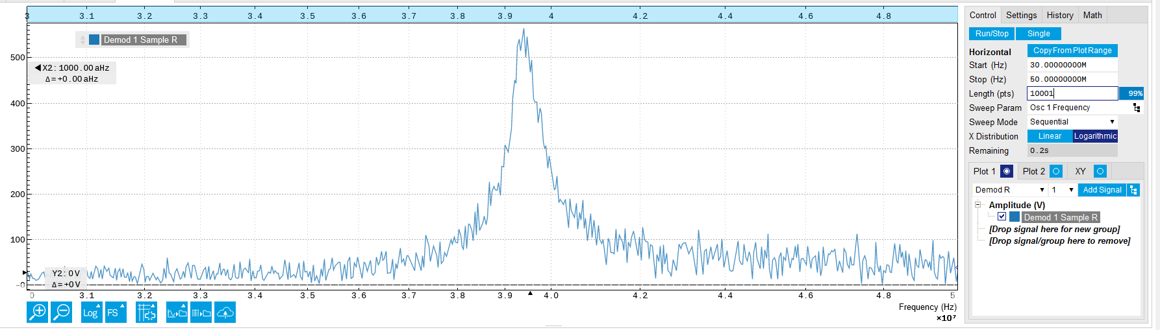

Slide 11
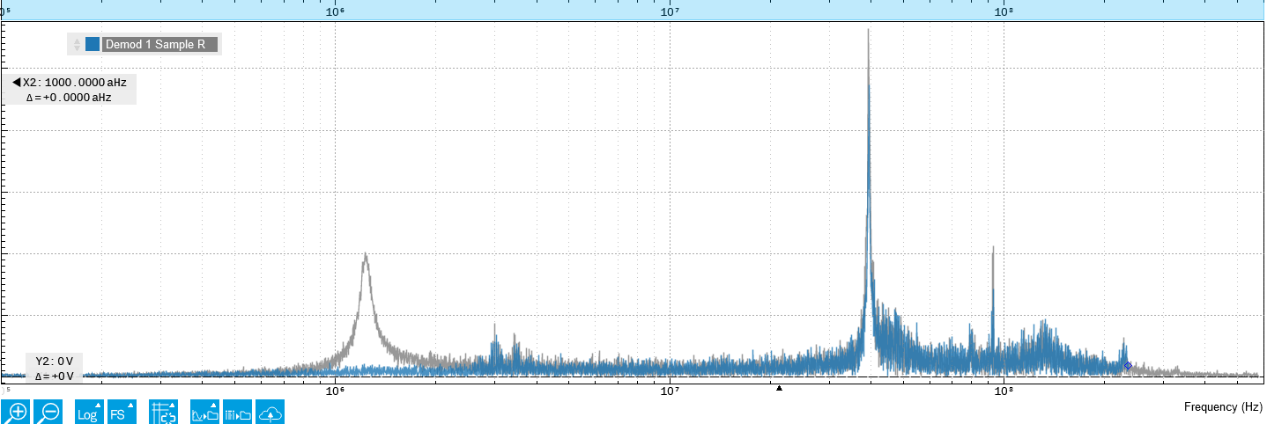

Slide 12
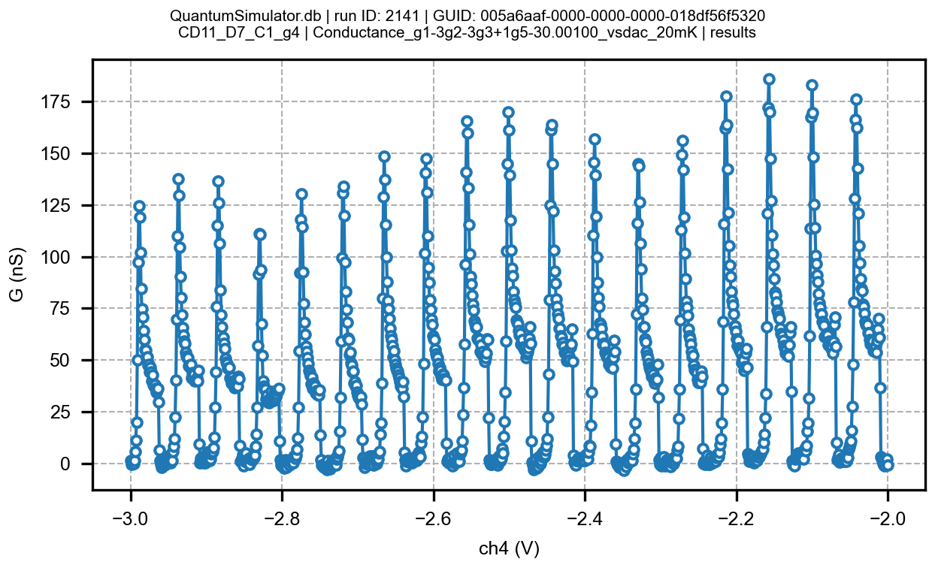

Slide 13
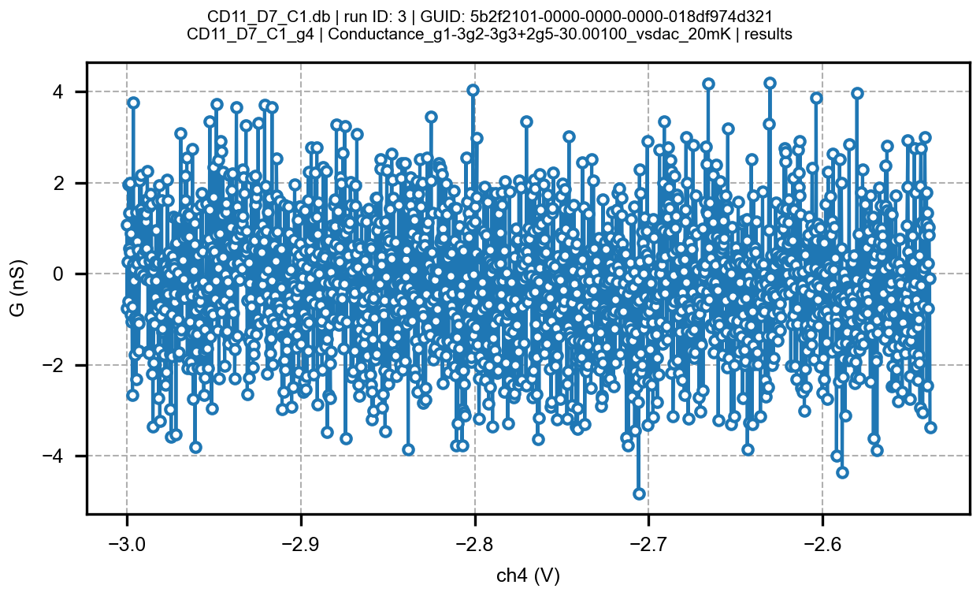
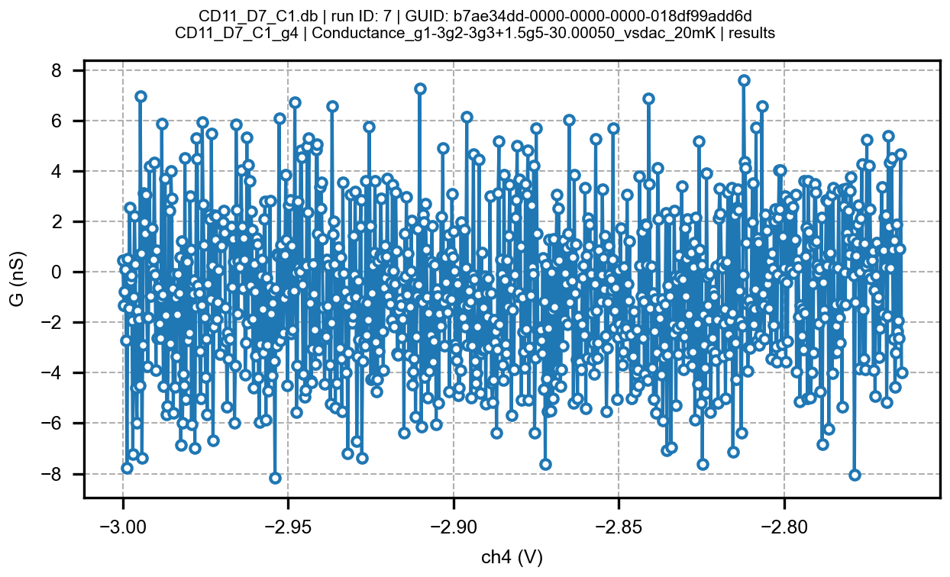
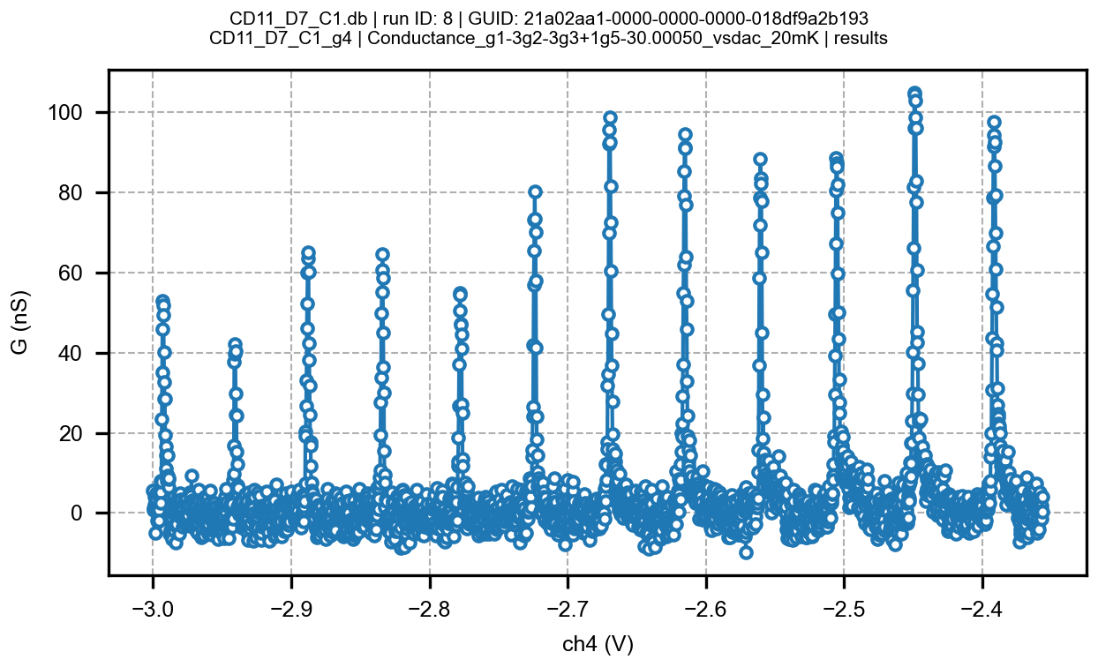
Determining maximum positive central barrier voltage to achieve transport; rest of gates p-doped
Vgcs=0
Vg1=-3
Vg2=-3
Vg5=-3
Vg4: sweep
Vg3=+1.5
Vg3=+2
Vg3=+1

Slide 14
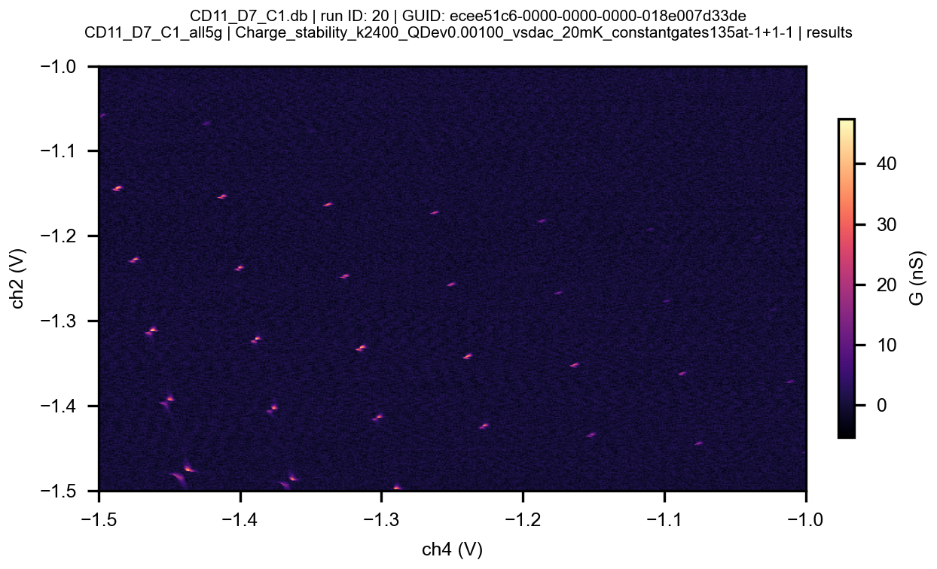
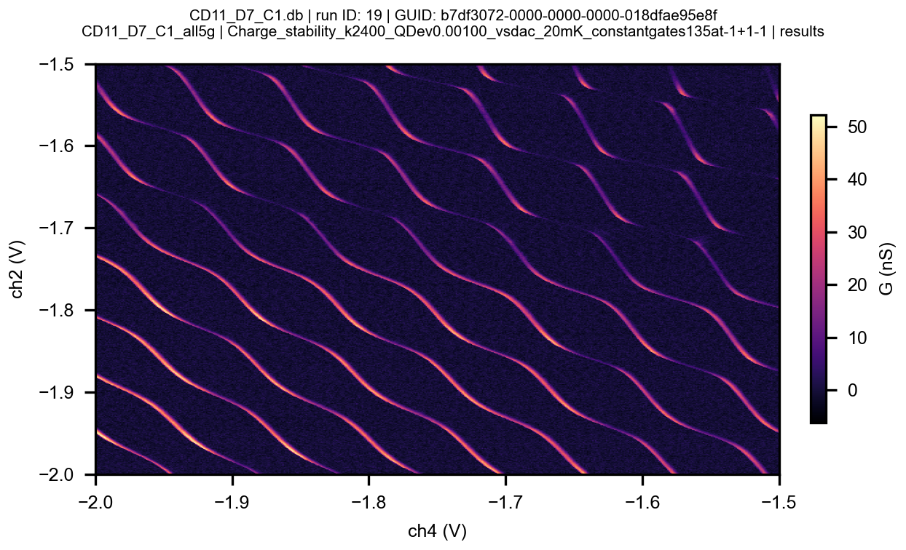
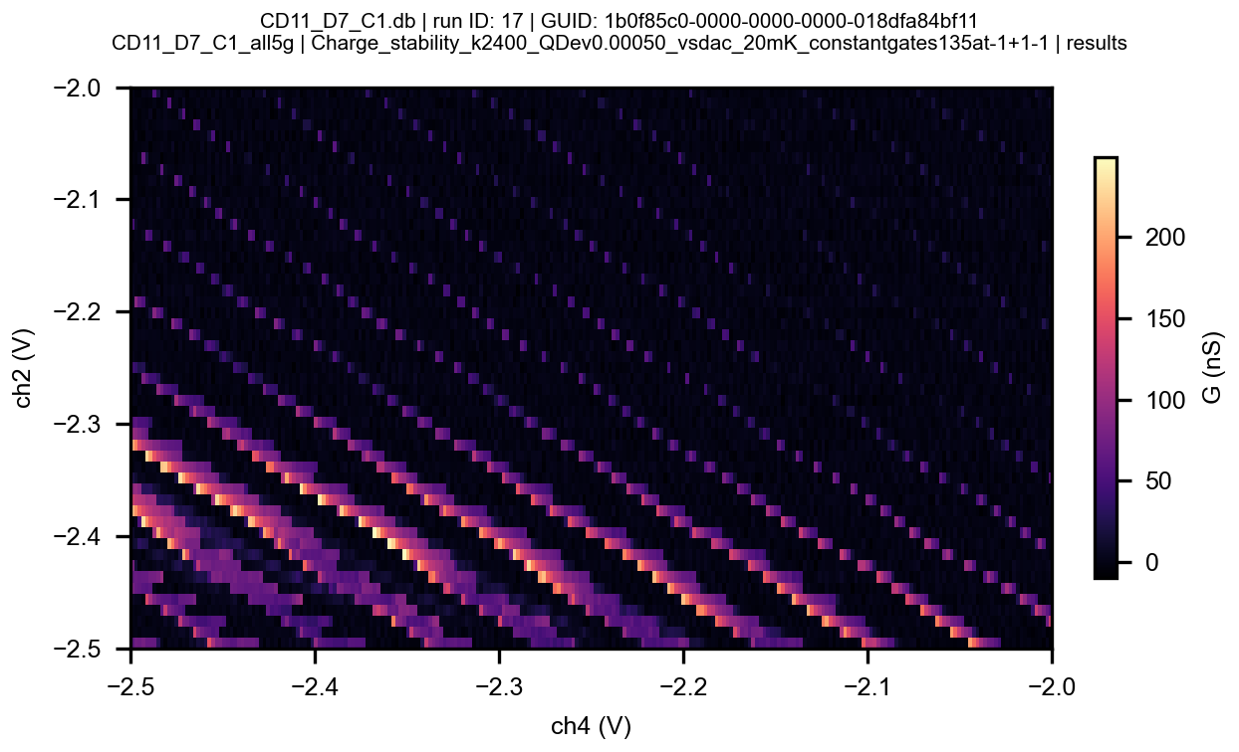
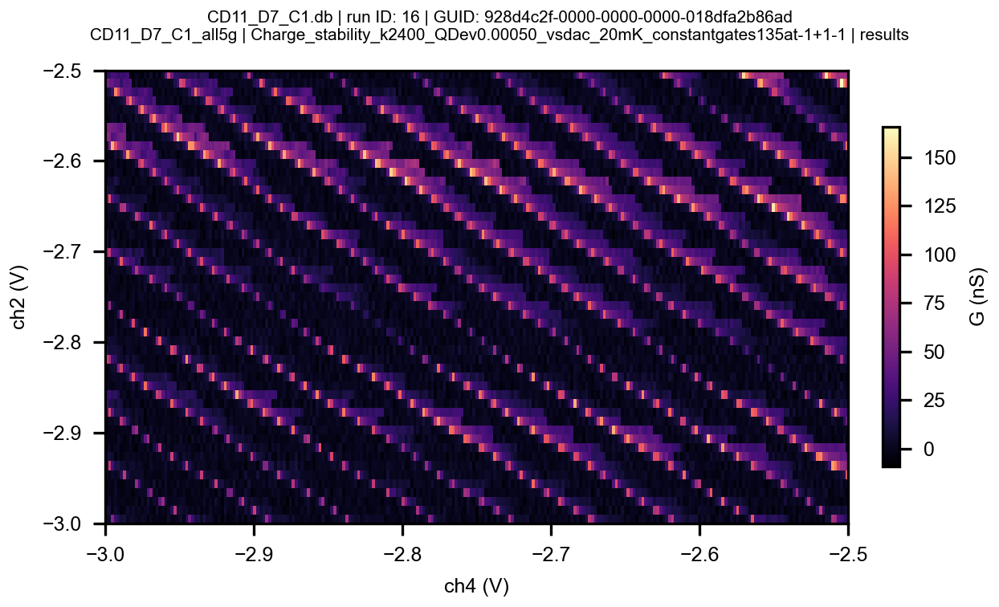
Vgcs=0
Vg1=-3
Vg3=+1
Vg5=-3
Vg,24: sweep

Slide 15
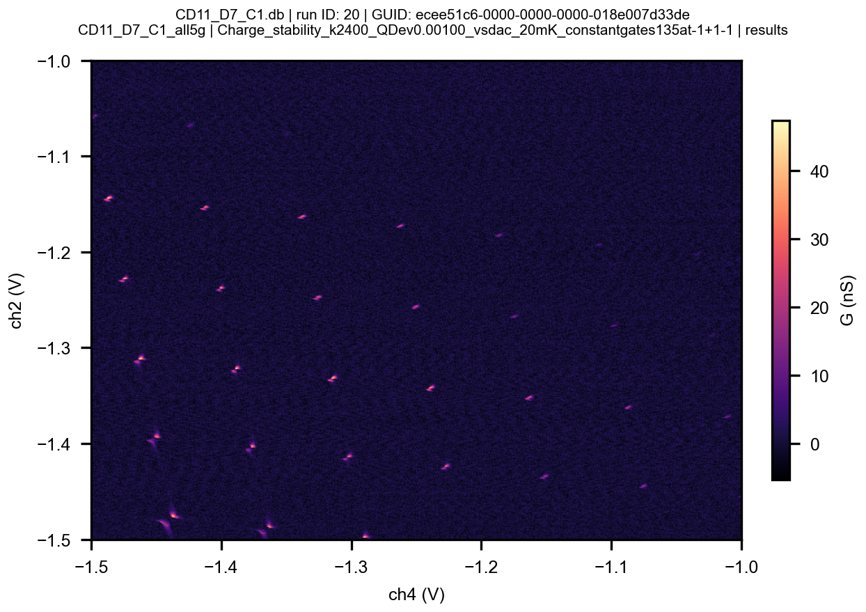
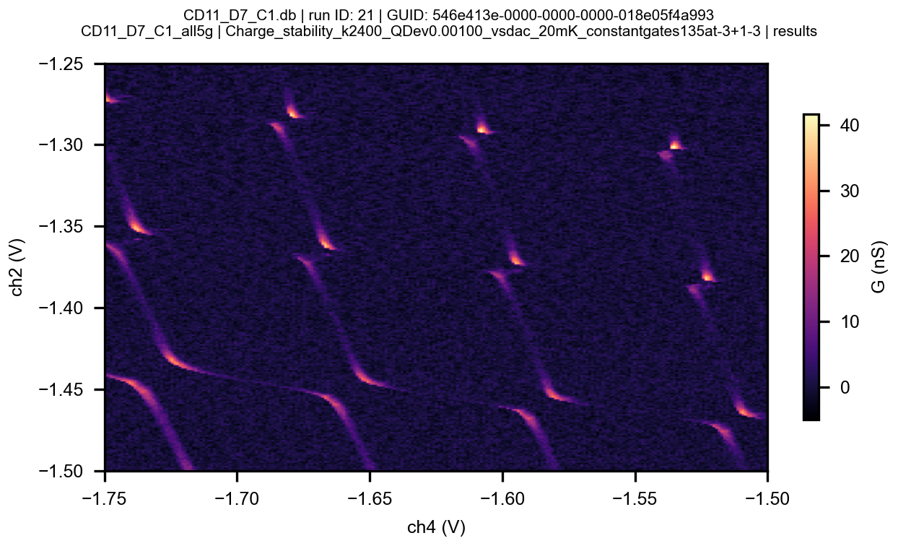
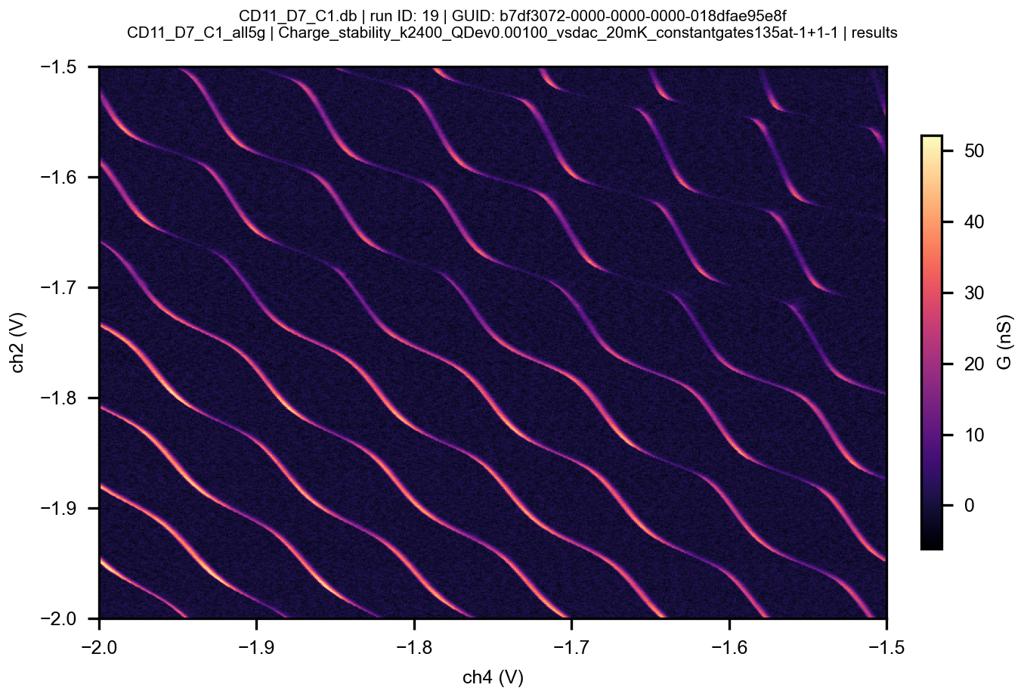
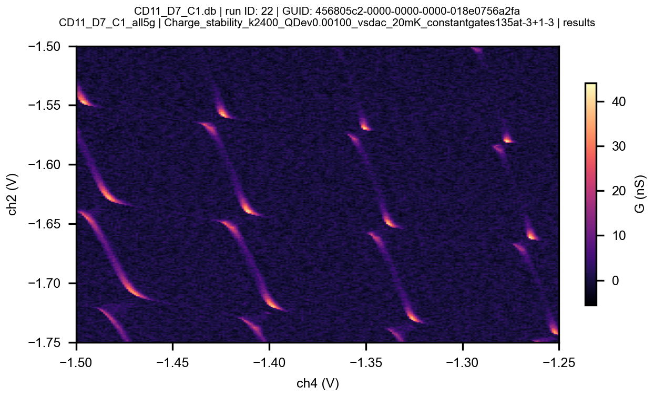

Slide 16
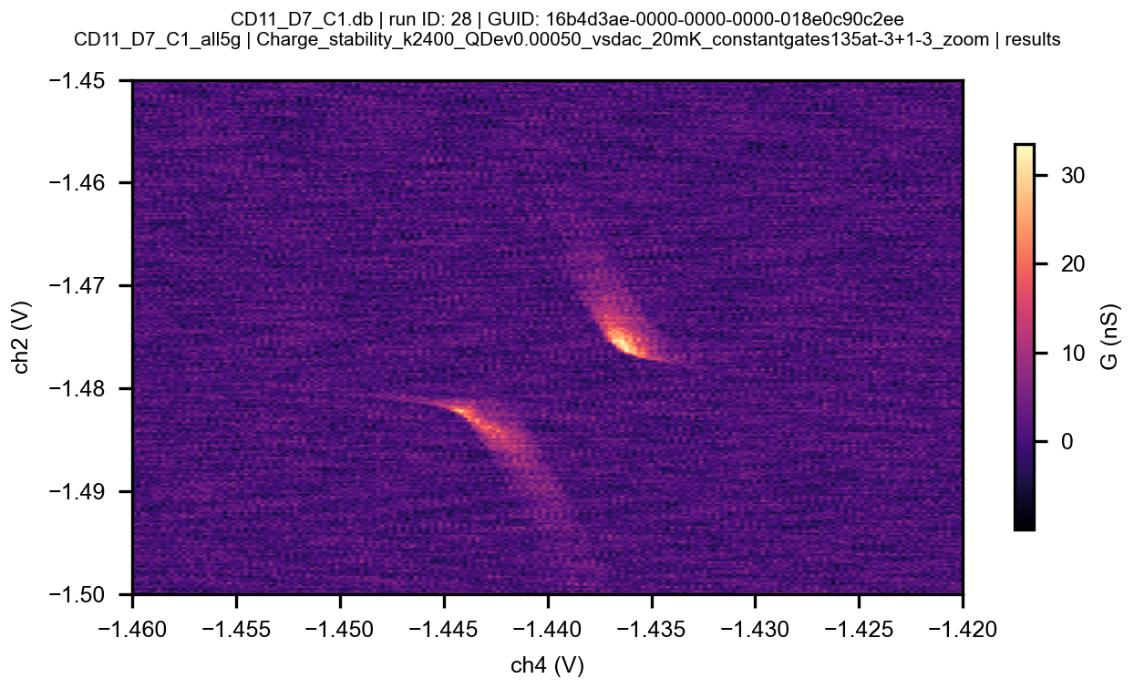
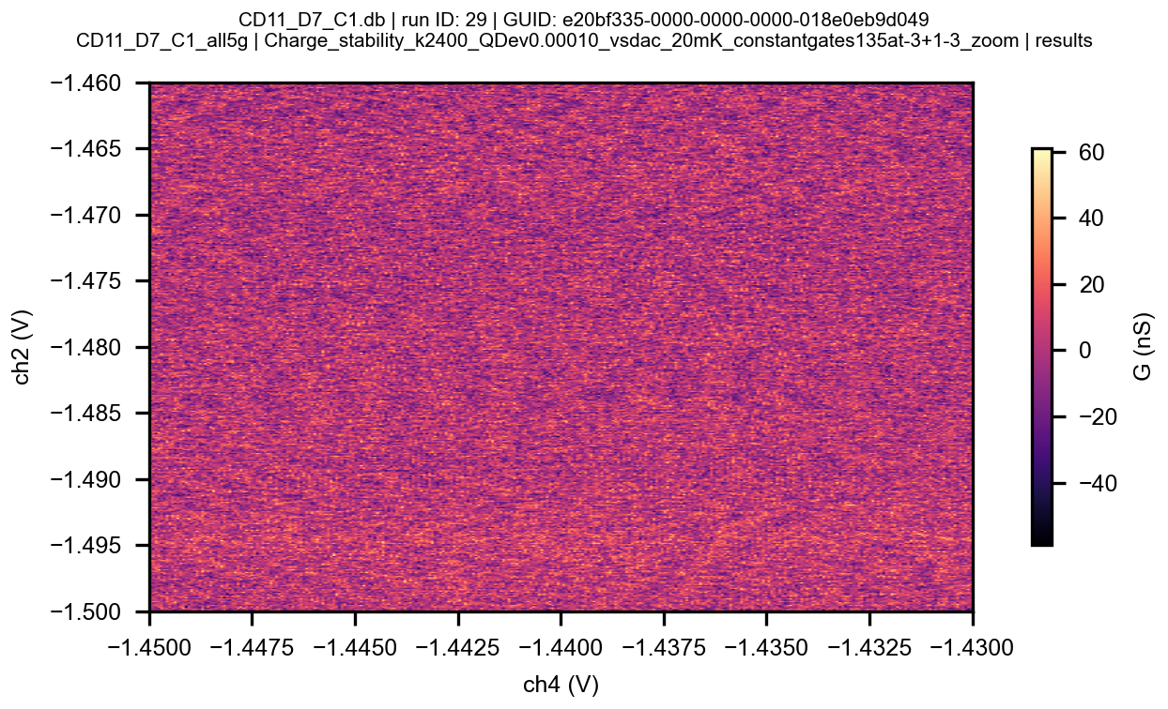
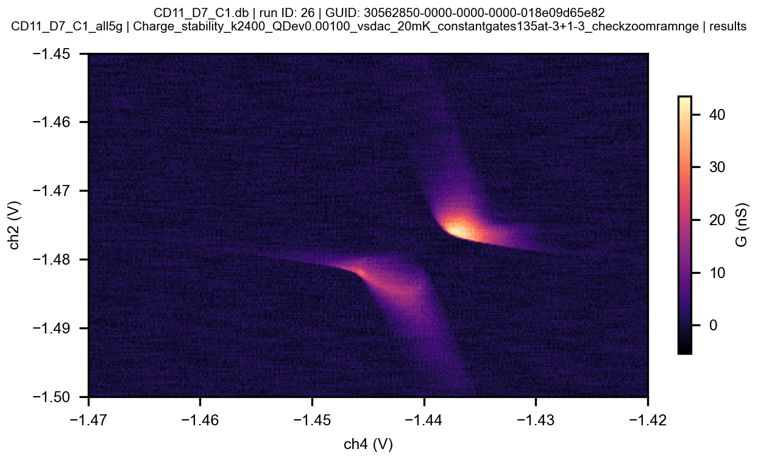
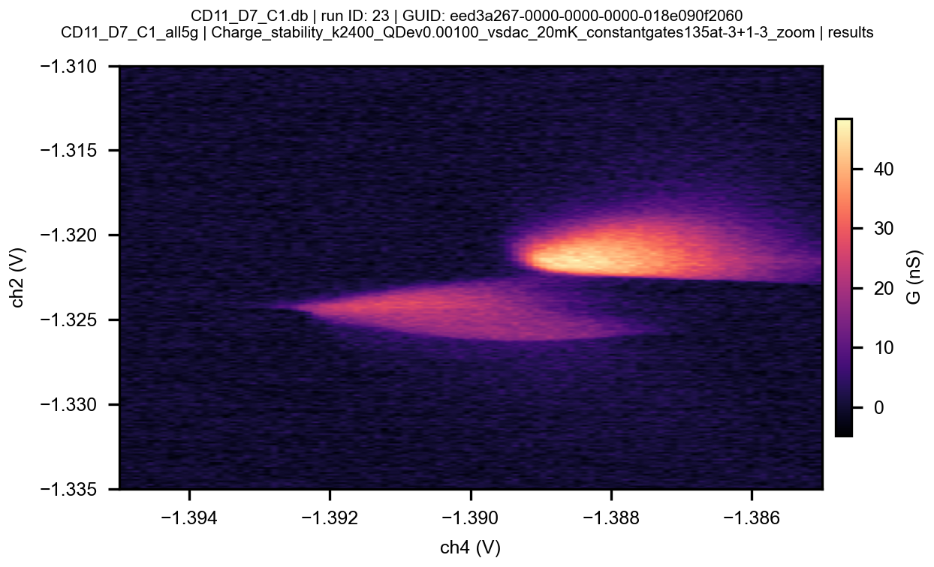
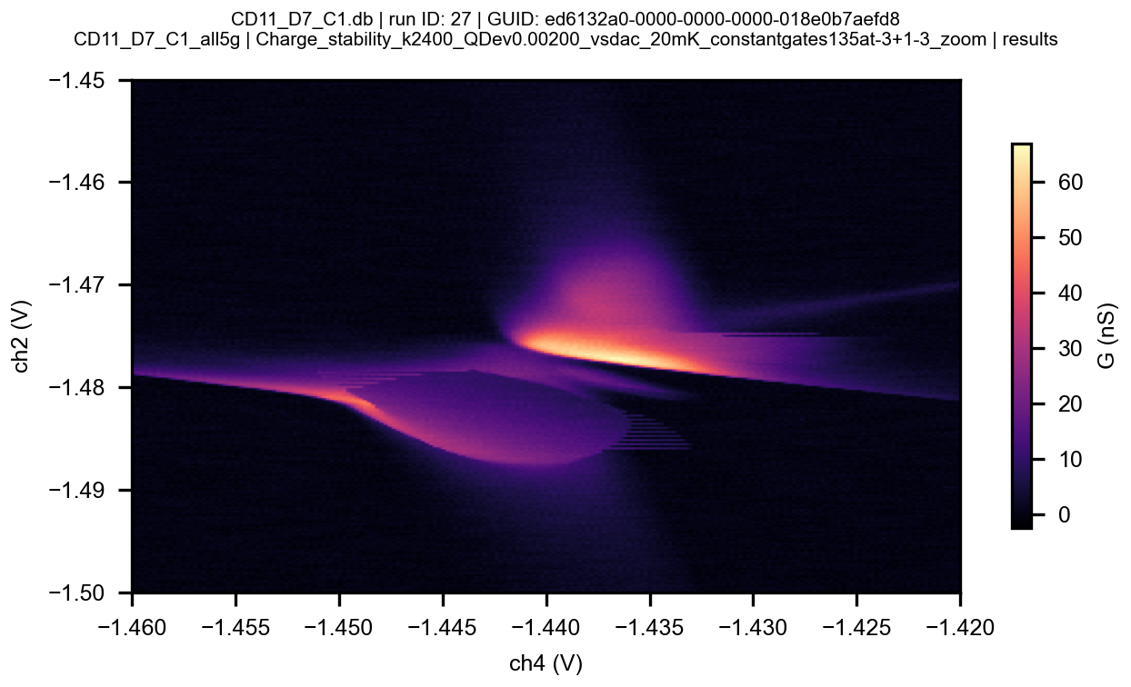

Slide 17
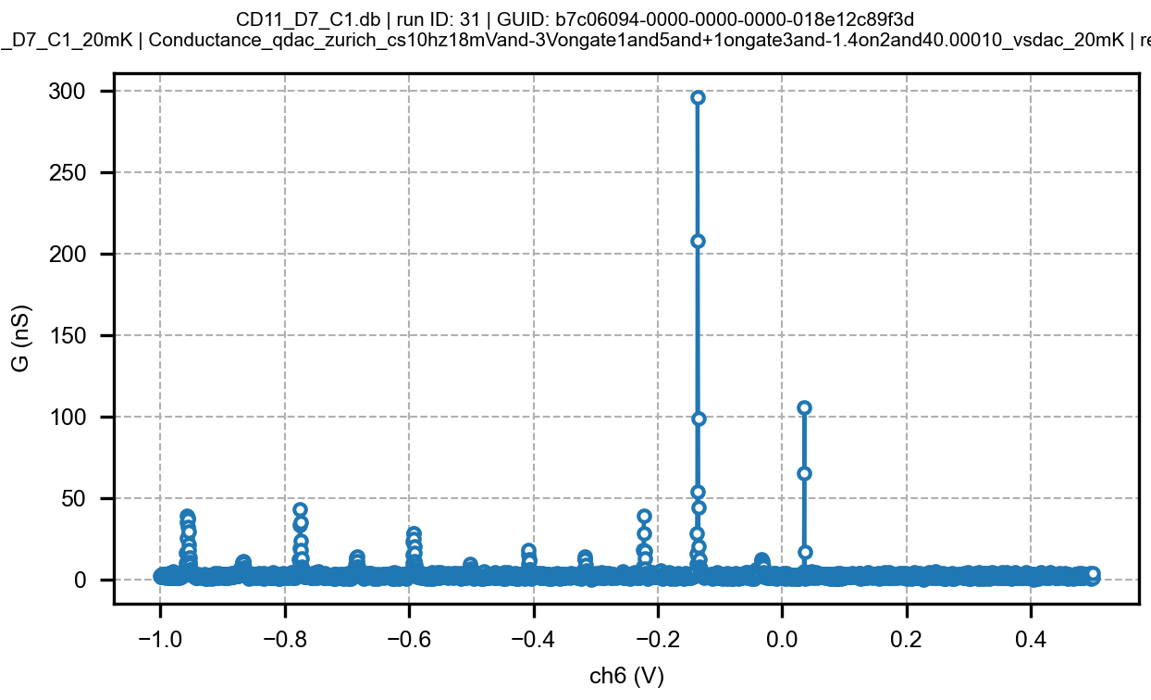
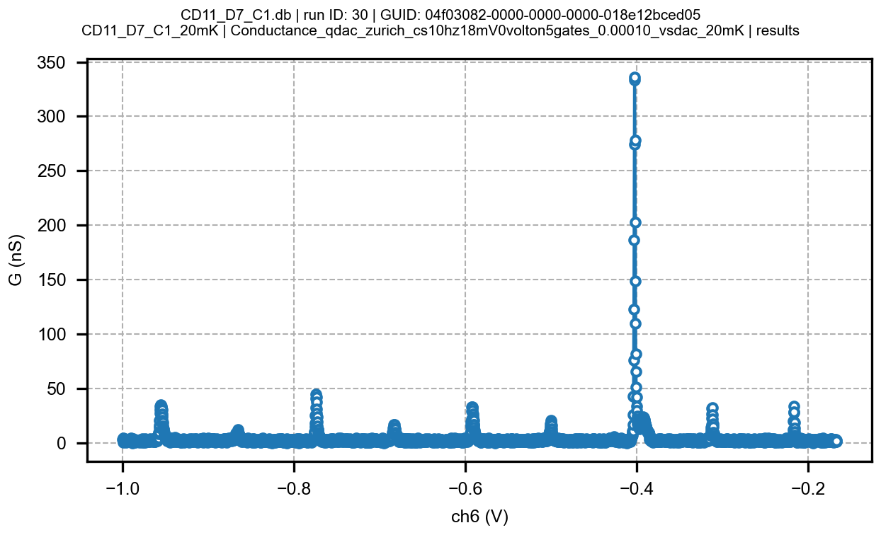
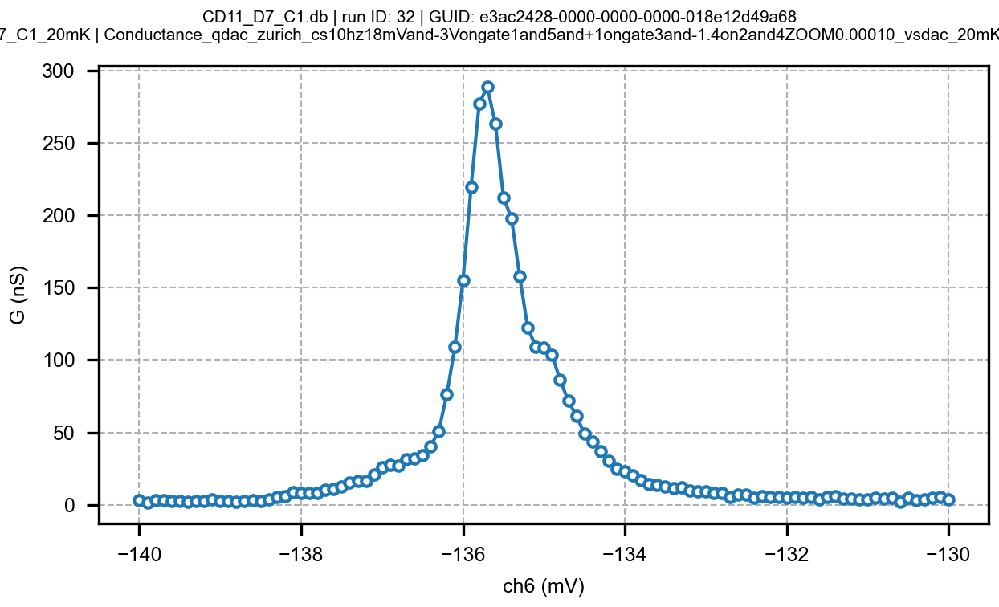
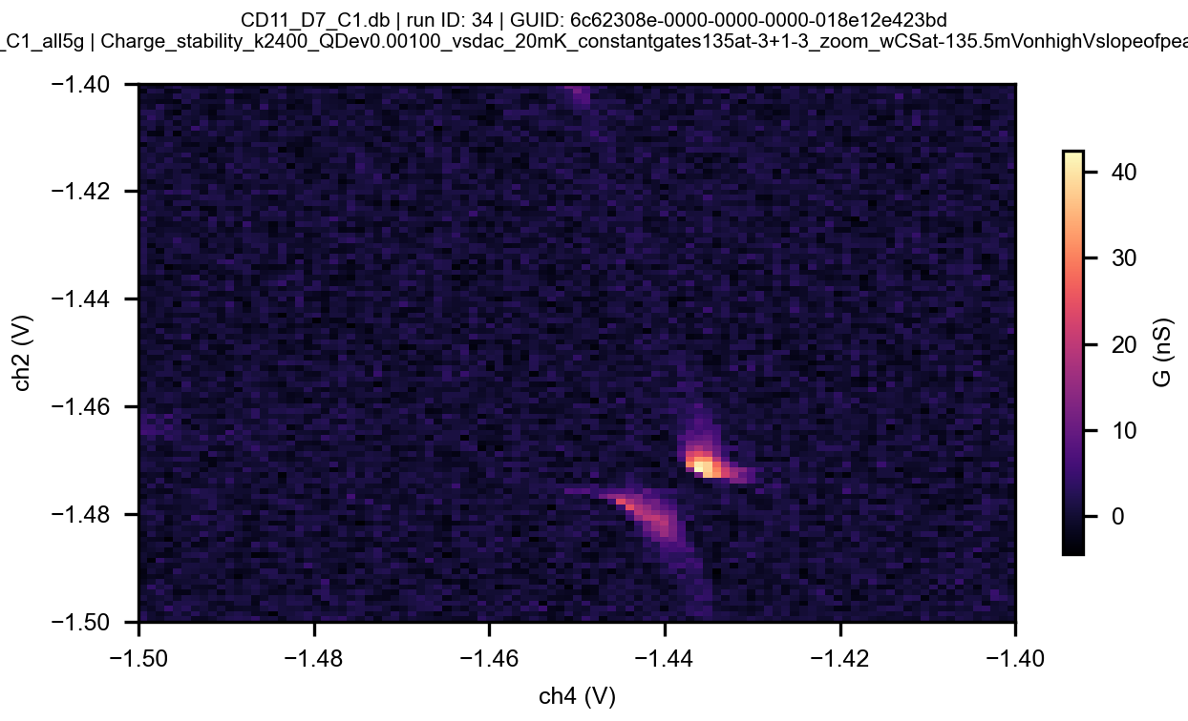
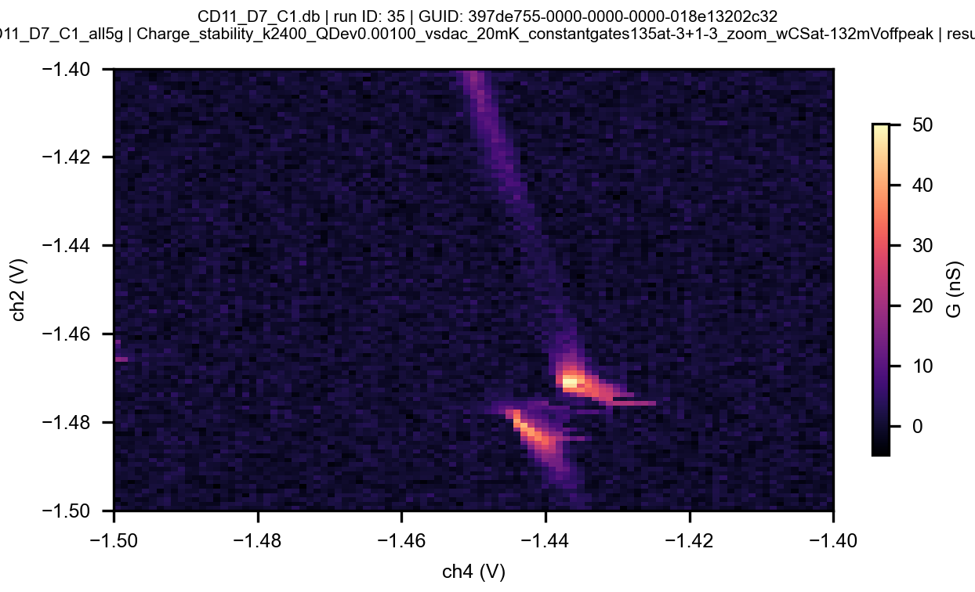

Slide 18
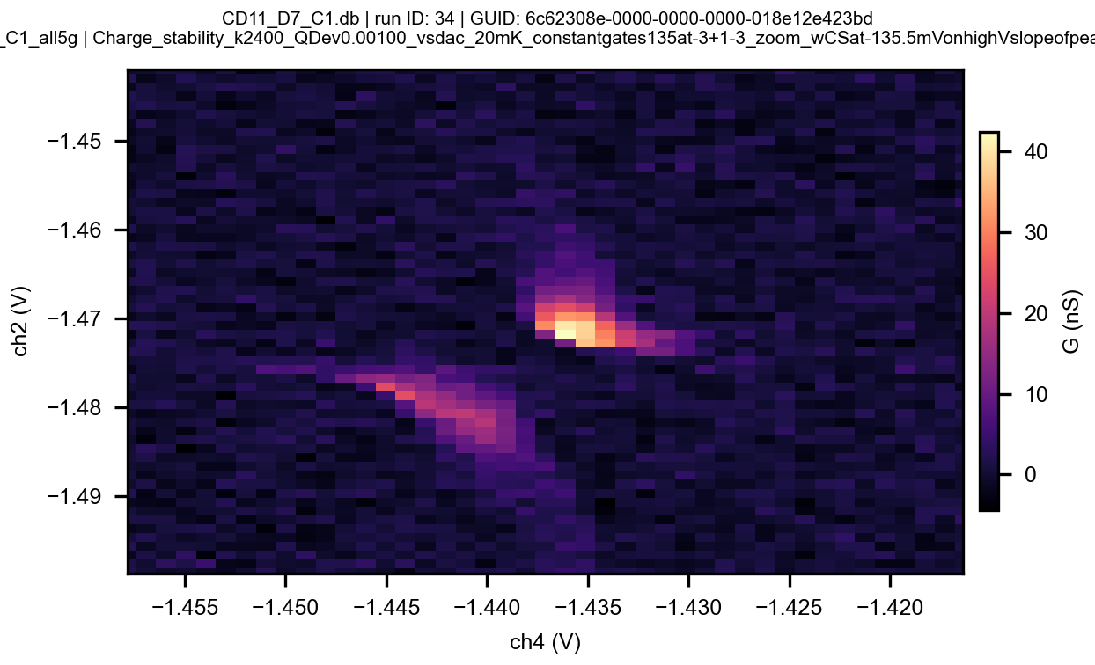
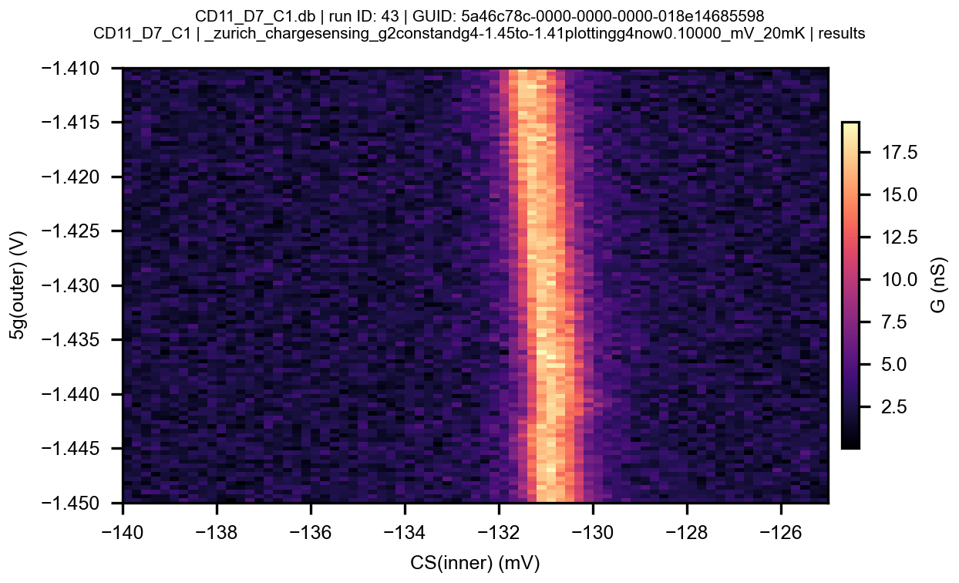
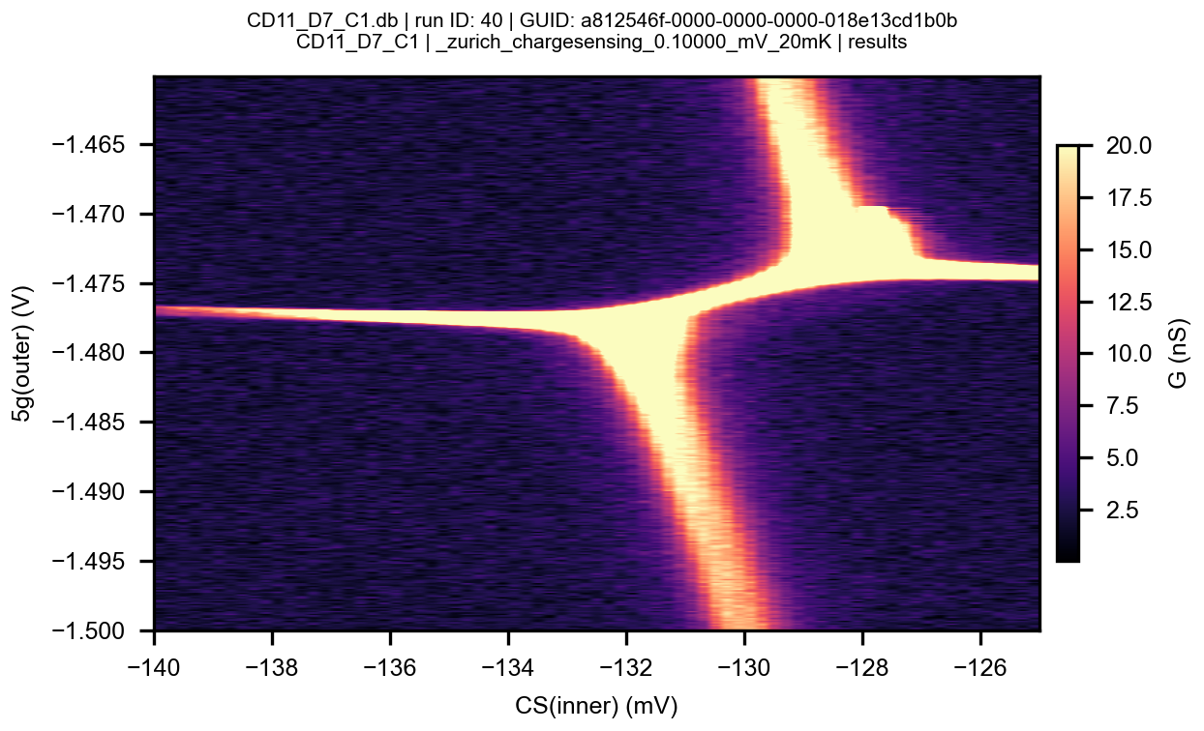
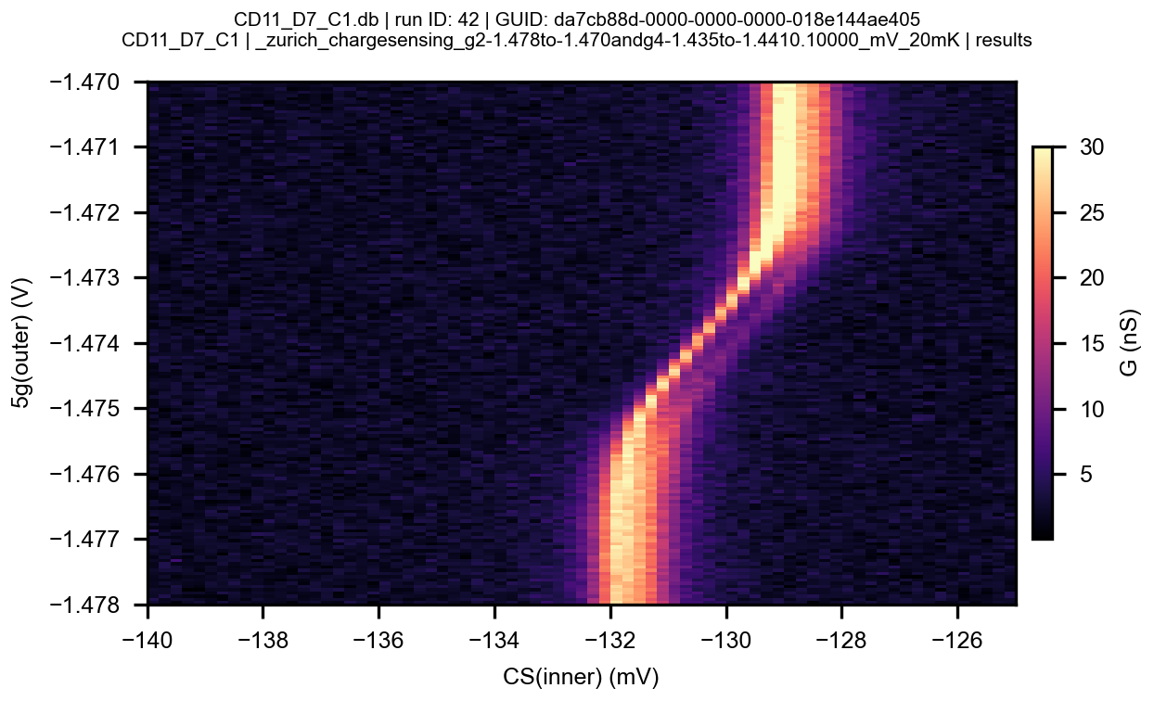
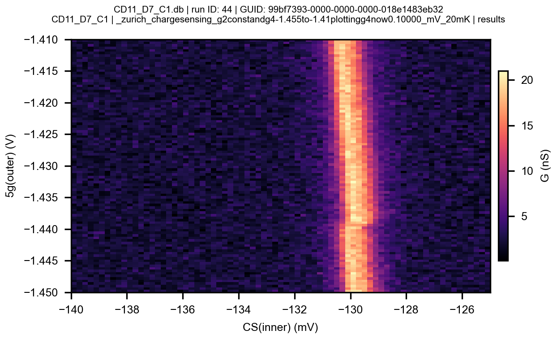
Assuming leverarm of 0.2 for single gate gives 2t ~ 200 GHz

Slide 19






Slide 20



Slide 21


20mK, SL gnd via instrument
~48h
GVg for each point
Very slow!
V_peak

Slide 22






20mK, SL gnd via instrument
Determining cross-capacitance
Sit at -12995/12.5nS
x
x
Peak at -129.5 (pm 200u)
Therefore cross-capacitance:
3/40=7.5%pm~0.8%
Peak at -132.5 (pm 200u)

Slide 23




20mK, SL gnd via instrument
Determining cross-capacitance
-132.8
Mislabelled: g2g4bothat-1.43
Therefore cross-capacitance:
0.8/40=2%pm~0.8%
-132.0

Slide 24








20mK, SL gnd via instrument
Sitting on side of peak, adjusting for cross-capacitance
Best
Fast (5 min)! But falls off peak eventually

Slide 25




Slide 26
Too high
Too low
Sitting on side of peak
GVg for each point
If conductance is too low or too high
Next measurement
V_peak
Calculates G
Calculates V_peak
Infer V_peak from last measured slope
X
 |  |  | X

Slide 27



20mK, SL gnd
Combined approach
Problem:
Slope not correct
Still very slow,~12h, nearly all time spent on GVGs, still errorprone!

Slide 28

Further improvements
Infer peak position from whole measured shape, rather than slope (improves precision)
Adjust CS voltage back to setpoint based on last measured shape (improves speed)
Adjust Vg_cs if it deviates from setpoint too much, based on last GVg

Slide 29

20mK, SL gnd
~4 hours, still some mistakes (lost peak) -
Dynamically adjust voltage range for peak search (start with small scan, check if peak found, then increase scan range)
-> should increase speed and reduce errors

Slide 30




20mK, SL gnd
Code mostly works now except for rare mistakes
Rough scan of transition: 20 min
Peak slipping under G and increasing
jump

Slide 31


20mK, SL gnd
Using other peak – but it disappears into noise at some point!

Slide 32



20mK, SL gnd
Second peak shifts by large amount (1:1) – strange effect!
Remember for later, and change 5-gate voltages for now to reduce coupling!

Slide 33


20mK, SL gnd
Vgcs=-3
Vg1=+0.6
Vg3=+1.1
Vg5=0
Vg,24: sweep
6h per meas

Slide 34




20mK, SL gnd

Slide 35


Measurement time 6 min

Slide 36



Slide 37




Acc repeat

Slide 38


Slide 39

Diagonal scan
g2andg4

Slide 40

Diagonal scan
g2andg4

Slide 41


Diagonal scan
g2andg4
g2andg4

Slide 42


Diagonal scan
g2andg4
g2andg4

Slide 43



Diagonal scan
g2andg4
g2andg4
Weird!
g2andg4

Slide 44


Diagonal scan
g2andg4
g2andg4

Slide 45


220323 6:30pm SL float
Stability diagrams with new code:-2 to -1.5V
Cf transport
Vg4
Vg4

Slide 46




Stability diagrams with CS: -1.5 to -1V
See also diagonal scan on lside before last
Vg4

Slide 47


Stability diagrams with CS: -1 to -0.5V

Slide 48


Stability diagrams with CS: -1 to -0.5V
Confirming with peaksweep??
Vg2
Vg2
??

Slide 49





Stability diagrams with CS: -0.5 to 0V
Confirming with peaksweep??
Vg2
Vg2

Slide 50


Confirming with peaksweep
g2
1.25
g2

Slide 51






Zoom on triplepoints
maxpos
Vg

Slide 52




Zoom on triplepoints
maxpos
Vg

Slide 53

Swap inner/outer gate

Slide 55


Super-CS-peaks

Slide 56













Super-CS-peaks
-2,-2
+1mV steps on g4
3
Distance betewwn peaks
0
2
1
4
5
6
7
8
11
9
10

Slide 57



Slide 58


2-4/04/24 – ramp down everything and change pc - recalibrations
Imperfect compensation
Withg1-g5at0V,50mVAC

Slide 59
Lever arm=0.22

Slide 60



Ramped gates back to g135=0.6,1.1,0V; SL and SR floating
G2g4 at -1.5
G2g4 at -1
G2g4 at -1and-0.75

Slide 61


Ramped gates back to g135=0.6,1.1,0V; SL and SR floating
g4 at -0.75
Compare to measurement before ramping
After pc change
Before pc change

Slide 62

Recharacterization after pc change
Drift?

Slide 63




Drift analysis
Meas 542; 5/4/23:00(-1.9983-1.9356)
Meas 524; 4/4/03:00(-1.9983-1.9356)
X
X
X
Meas 544; 6/4/20:00(-1.9987-1.9360)
Meas 543; 6/4/13:00(-2.0002-1.9377)
X
X
X
X

Slide 64


Drift analysis
Error appears sometime during measurement and stops measurement – eg all measurements on Monday 8/4
Meas 545; 7/4/11:00(-2.0009,-1.9383)
Meas 549; 9/4/12:00(-2.0015,-1.9392)
X
X
X
X
X: previous
X: current

Slide 65
For comparison: before pc change
Meas 484; 29/3/23:00(-1.9237,-1.9505)
Meas 485; 30/3/03:00(-1.9241,-1.9507)
X
X
X
X
Meas 488; 30/3/11:00(-1.9244,-1.9509)
X
Drift was maybe a factor 10 smaller!

Slide 66



10/4/24
Look for different voltage range – maybe drift is smaller
G2,g4 at -1.5V
Rough scan to find a transition
Try two measuremnts in a row but:
Computer switches off/reboots randomy! Second measurement coundnt finish! This happened for second time (last time Thursday/Friday night). Luckily qdac connection doesn’t get blocked.

Slide 67

Different transition, still shifting

Slide 68


Sidetrack: errors appearing since we have the new pc:
Also this happens sometimes, stops the measurement but doesn’t break the connections
Now Zeshan connected lab via
Usb-adaptor, and internet via main lan.
DNS configuration 8.8.8.8 seems required by python
Sl,sr gnd, 18mK

Slide 69

11/4/24 SR GND (GND while putting all 5g voltages to -3V)
Compare to before pc change: same position within about 1mV!
Sl,sr gnd, 18mK

Slide 70

meas627
Sl,sr gnd, 18mK

Slide 71



Quite consistent
After going to V=+1.9
X
X
Sl,sr gnd, 18mK

Slide 72



Mechanics chargesensing – attempts with rhode
Mechanics run 641
x
Sl,sr gnd, 18mK

Slide 73


Mechanics chargesensing – attempts with rhode
Mechanical frequency measurements sitting at Vgcs=-0.34045
-20 db nothing
Sl,sr gnd, 18mK

Slide 74


Mechanics chargesensing – attempts with rhode
Power line 2=0
Step=10kHz
Cs peaks after mechanics
Sl,sr gnd, 18mK

Slide 76




Mechanics chargesensing – attempts with rhode
Run mechanics 650
0db too big??? I try to sit at -0.34112 and run over night
Sl,sr gnd, 18mK

Slide 77




Mechanics chargesensing – attempts with rhode
The transition moves a lot during the night.
Maybe this one the reason no mechanics?
Barrier gate 3 V= 1.1V
Sl,sr gnd, 18mK

Slide 78



Mechanics chargesensing – attempts with rhode
Barrier g3 Vg3= 1.13
Barrier Vg=1.112
Barrier Vg=1.1
Sl,sr gnd, 18mK

Slide 79



Mechanics chargesensing – attempts with rhode
Rhode line 2= -10 dB
For running mechanics 657
Sl,sr gnd, 18mK

Slide 80




Mechanics chargesensing – attempts with rhode
Still in the transition after the mechanics measurement
Sl,sr gnd, 18mK

Slide 81
17/4/24
Found: at 110MHz rhode generated frequency and Zurich mixdown frequency are off by 85 Hz.
Switch rhode to Zurich. Implement digital compensation during measurment

Slide 82


Slide 83






Mechanics with Zurich
1mVrms on g2
RF off
RF on (~200uV@110MHz at gate2)
Sl,sr gnd, 18mK

Slide 84


Mechanics with Zurich
Moving_avg_30
1mVrms on g2
Disregard. Adjustments.
centered
Sl,sr gnd, 18mK

Slide 85




Mechanics with Zurich
After mechanics
Sl,sr gnd, 18mK

Slide 86

Mechanics with Zurich
Sl,sr gnd, 18mK

Slide 87

Mechanics focusing 92Mhz
Mechanics with Zurich
Sl,sr gnd, 18mK

Slide 88


Mechanics with Zurich
~1mV at gate
Sl,sr gnd, 18mK

Slide 89


17/18.4.24
Suspecting drifts (over about a week). Retaking stability diagram.

Slide 90







Less then 10 mins

Slide 91

Focusing on 74MHz
Out of resonance after mechanical measuraments

Slide 92







Meas756(IDT)
Meas758(IDT)
Meas757(IDT)
Meas738 (IDT)
Meas755(IDT)
Meas759(IDT)
Meas760(IDT)

Slide 93

Alpha almost 43 degrees

Slide 94


Slide 95





Rf set to 11mV on gate2
Before mechanics
After the mechanics
mes801
mes802
Frequency sweep
Frequency sweep

Slide 96


Studying how frequency change with voltage applied to gate 2
22 mV g2
11mV g2
mechanics

Slide 97


Changing the low pass filter to 1 Hz. Why the signal get worst????

Slide 98




meas822

Slide 99




Studying the peak at 57 MhZ as a function of the power
6 mV
11mV
meas822
Current (A)
Current (A)
Current (A)
Frequency (Hz)
Frequency (Hz)
15mv
22mV
Current (A)
Current (A)
Frequency (Hz)
Frequency (Hz)

Slide 100



15mv on g2
5 min
Meas881
Current (A)
Frequency (Hz)

Slide 101

15 mv on g2
22 mv on g2
220 mv on g2

Slide 102

15mV to G2
10 Hz step
Avarage 120
Meas 887
Current (A)
Frequency (Hz)

Slide 103



meas890
5mV to G2
10 Hz step
Avarage 120
4 mins
Current (A)
Frequency (Hz)

Slide 104

3 mV on gate2
meas891

Slide 105


10 mv on gate2
meas896

